Slide 1
Defining the model to SolidsPy_Dyn
Python script based upon meshio.py to convert the gmsh file into Solidspy text files
Gmsh model defined in terms of geometrical and physical groups
Text files defining the model for SolidsPy_DYN
(nodes.txt, eles.txt, mater.txt, loads.txt, inipar.txt)
preprocesor module in SolidsPy.py

Slide 2
Physical Problem

Slide 3
Geometric Groups
5
5
4
6
4
6
11
3
Line loop 10
8
7
3
9
2
7
Line loop 8
1
1
2
Plane surface
Line
Point
Line loop

Slide 4
Physical Groups
Physical point 500
Material profile 1
(Physical surface 100)
Material profile 2
(Physical surface 200)
Physical line 400

Slide 5


Subroutines contained in preprocesor
Physical line 400
Physical line 500
Material profile 1
(Physical surface 100)
Material profile 2
(Physical surface 200)

Slide 6
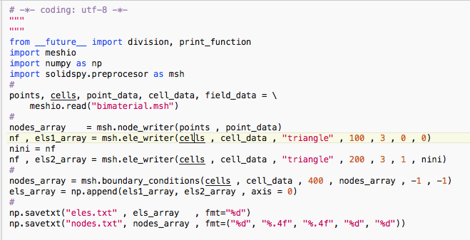
Step by step text files generation
Imports meshio
Imports preprocesor
Reads the mesh into python dictionaries
Creates the nodal array
Process physical surface 100
Process physical surface 200
Imposes boundary conditions along physical line 400
Concatenates the elemental arrays into a single array
Writes the files

